Slide 1
Rochester Fire Department and Fire Prevention
Group Members:
Nilesh Pawar, Ishan Shah

Slide 2
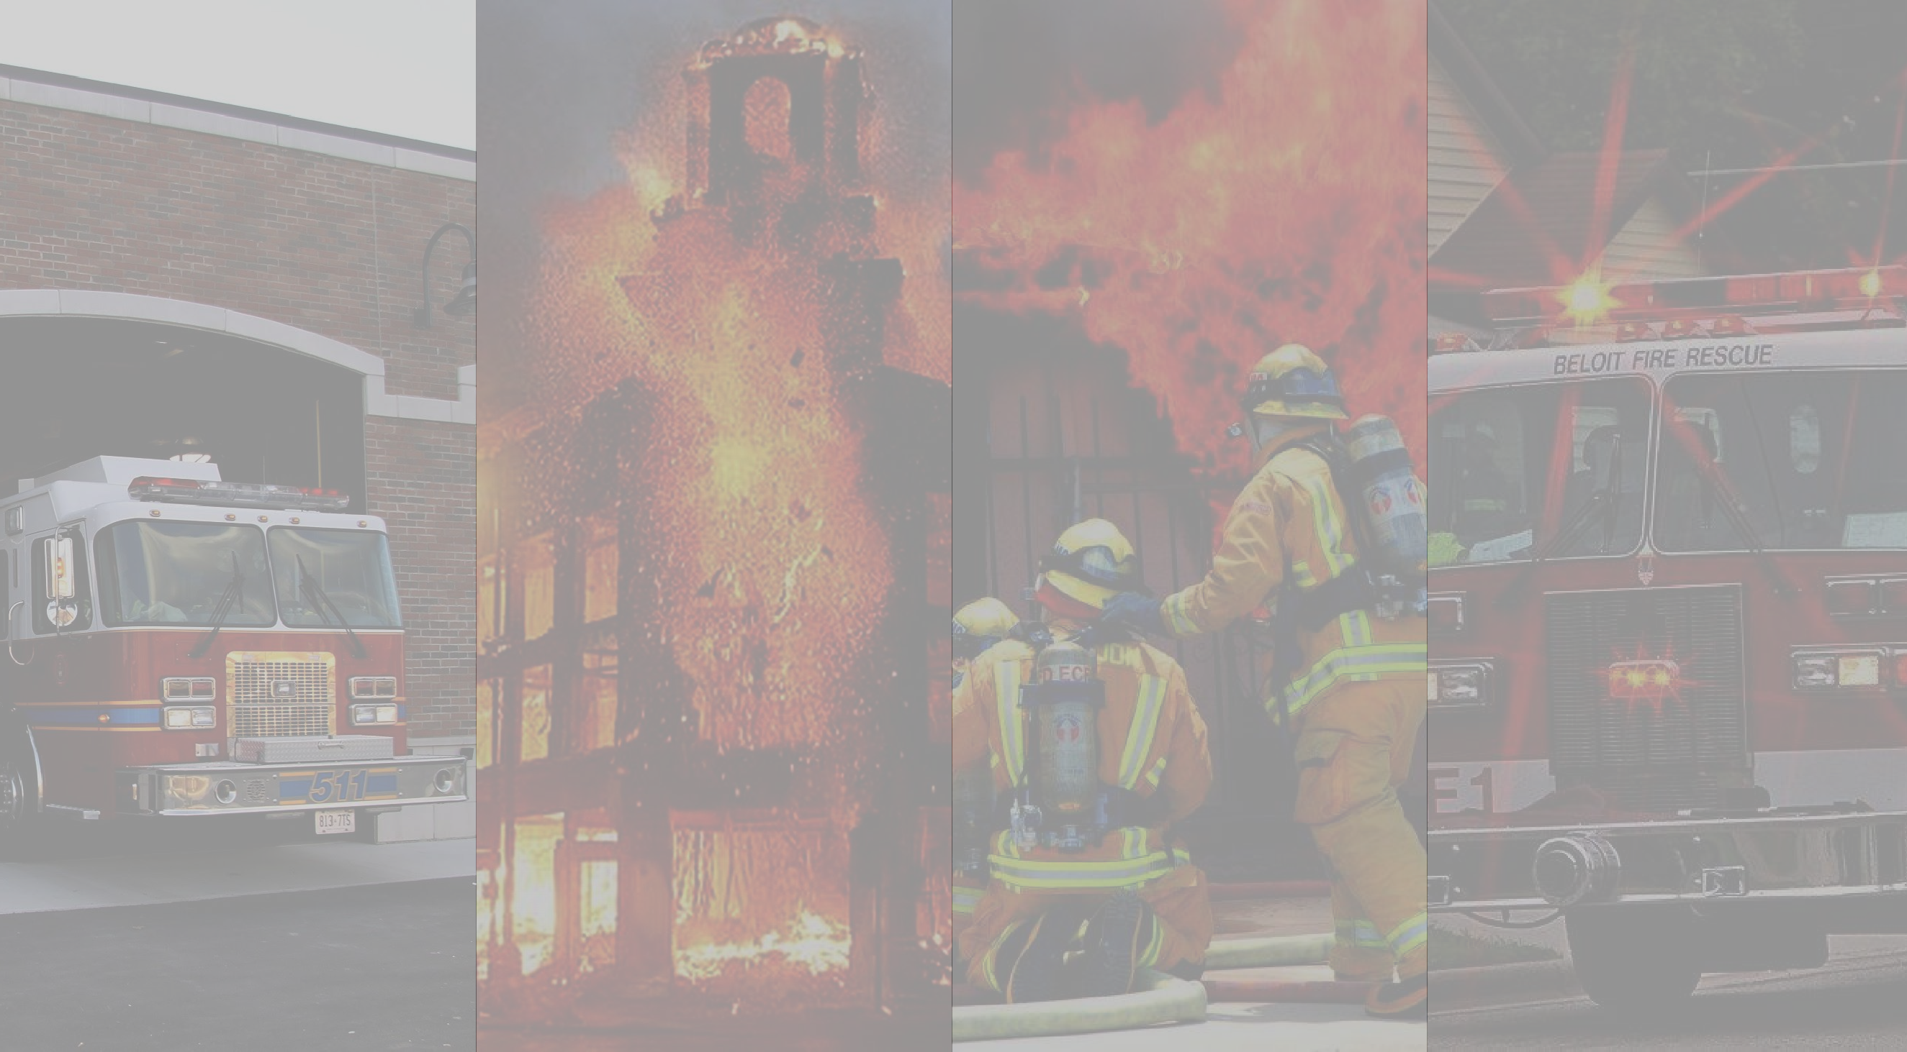




Slide 3
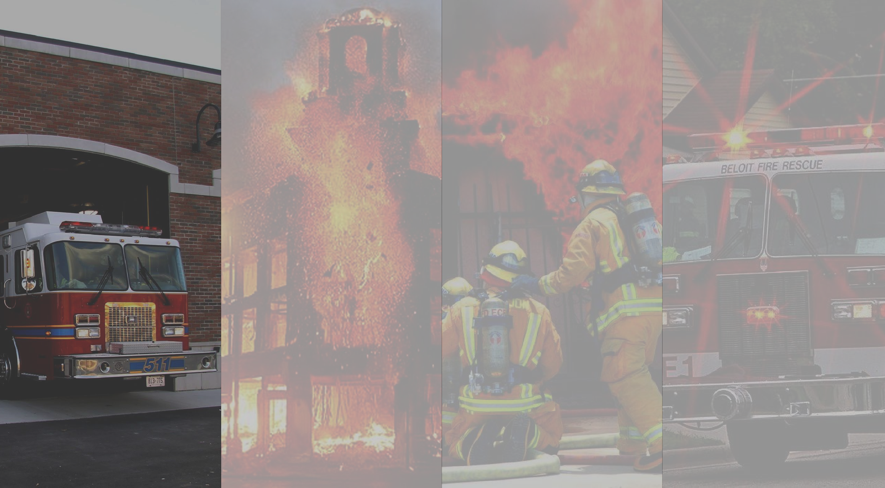



Slide 4
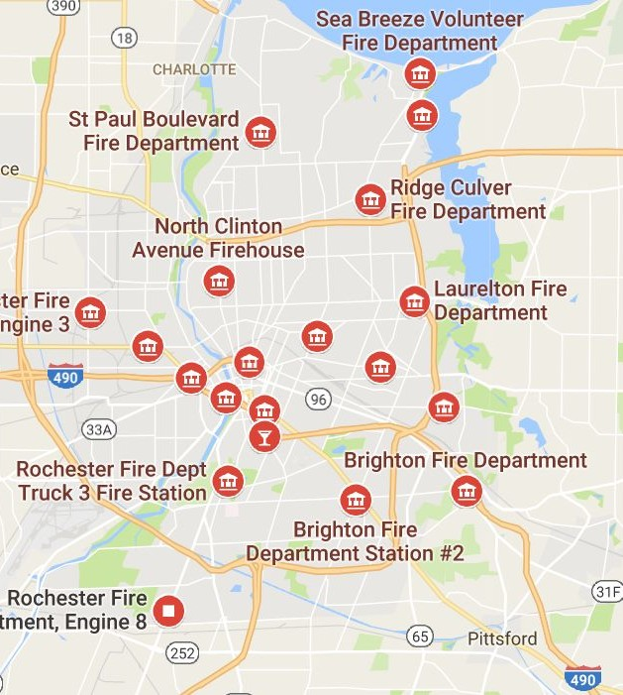
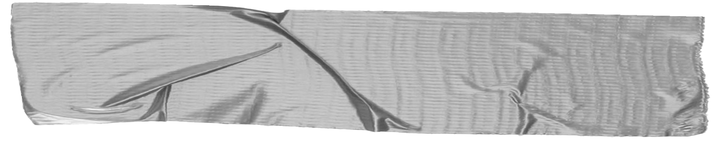

The Rochester Fire Department is a professional fire department tasked with ensuring the safety of those living, working, or visiting the
City of Rochester.
517 average fires per year
7800 average Inspections per year
65000 structures in City of Rochester
5

Slide 5
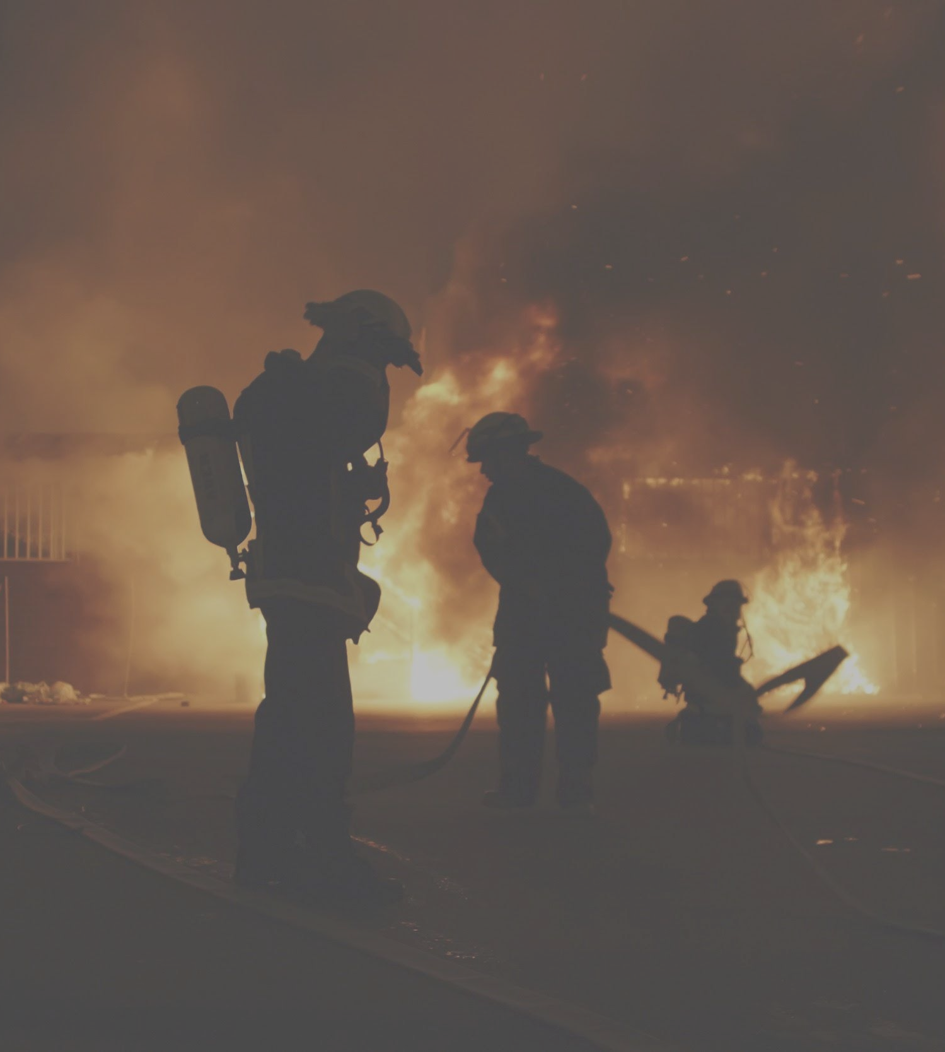


to identify where fires are most likely to happen by assigning inspectable buildings with levels of fire risk, taking into account various risk factors.

Slide 6
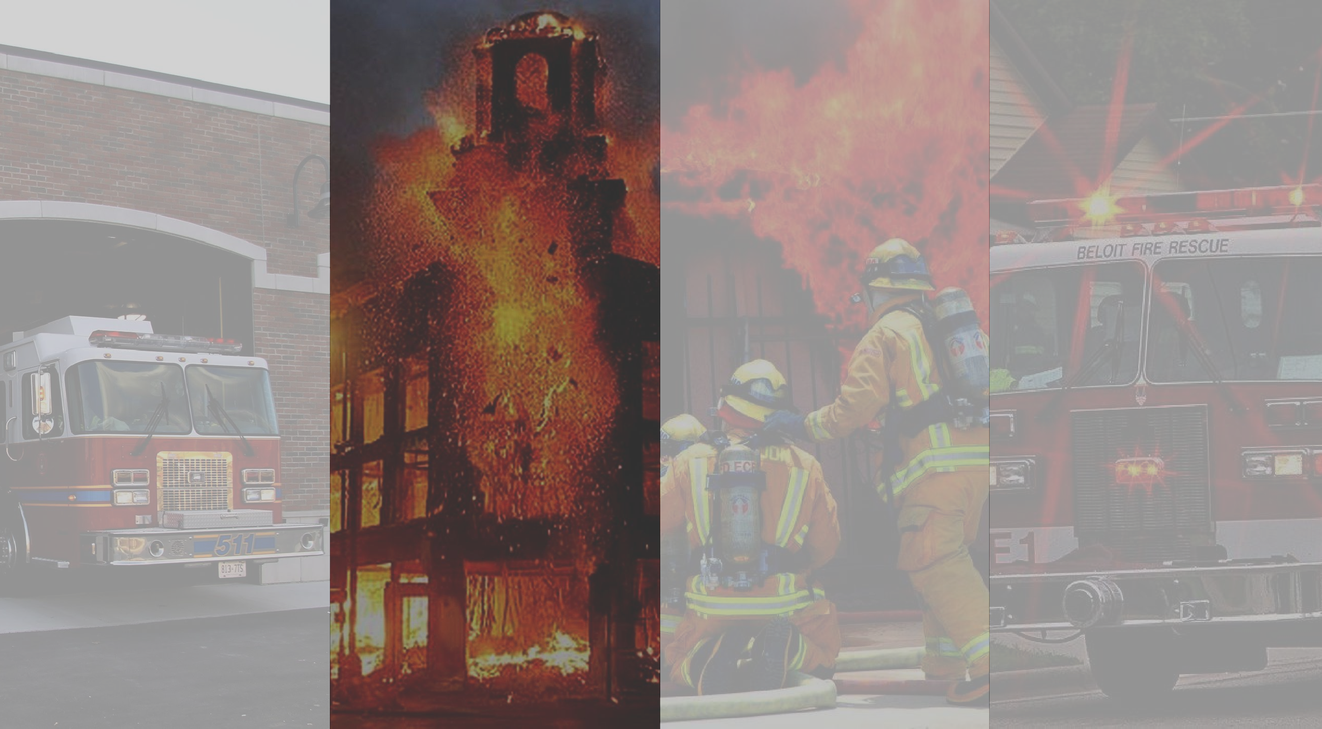


Slide 7




Modeling and Analysis
Data Understanding
Data Cleaning and Preparation
Visualization and Results

Slide 8







Fire incidents data
(Fire incident records about time, location, etc.)
Parcel data on all commercial-use parcels in Rochester
(Structure condition, year built, commercial usage, total value…)
Parcel data on all residential-use parcels in Rochester
(Structure condition, year built, square feet, building style, household type…)
Fire Risk Predictive Model
Census data
(Demographic data like percentage of children, poverty rate, education level)
Google Place API
(Conversion between address and coordinates)

Slide 9
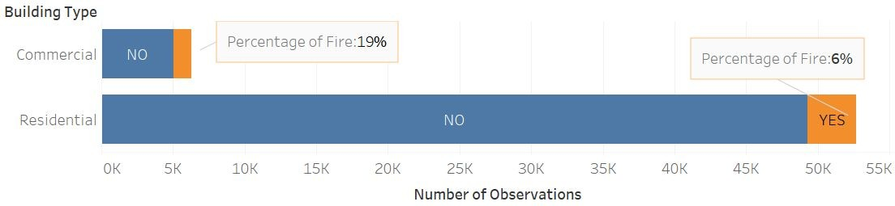
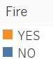
Percentage of Fire on Commercial and Residential Buildings

Slide 10

❏ Cleaning:
Deal with missing values, outliers, and aggregate duplicated observations.
Reduction:
Reduce unnecessary variables and variables with low variance using NZV.
Transformation:
Transform and construct new variables for model input.
Integration:
Merge fire incident data, parcel data and census data on parcel ID.

Slide 11
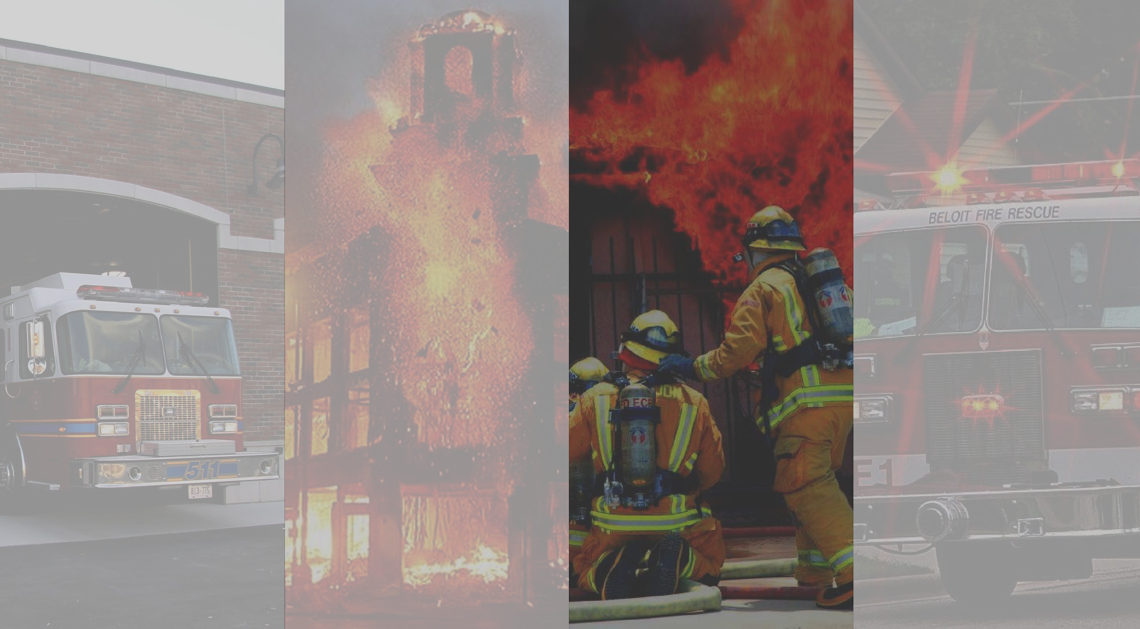

Slide 12
❏ Decision Tree
Given a set of conditions(columns/features/variables), what is the probability of a fire happening?
Random Forest
Bagging
Boosting
Support Vector Machine
Naive Bayes

Slide 13
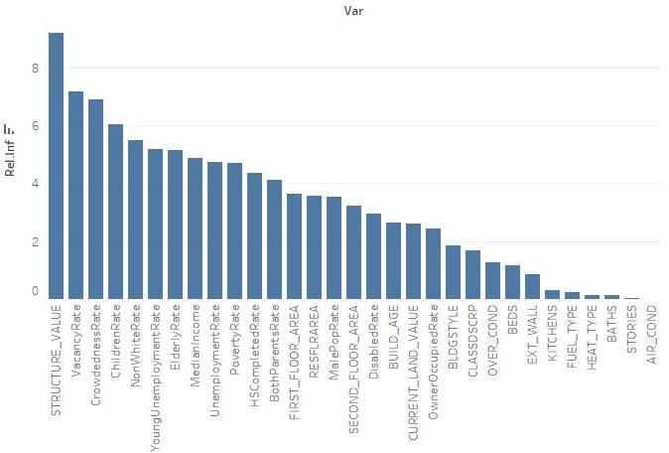

Slide 14
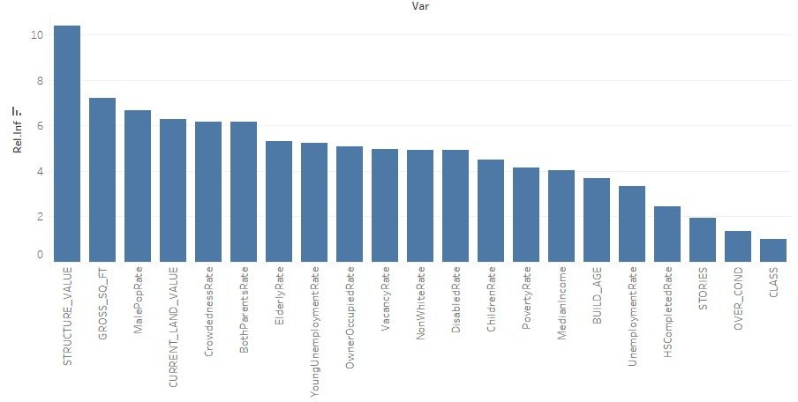

Slide 15
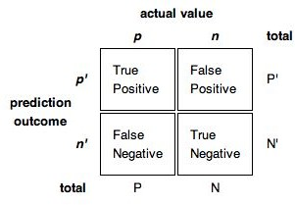
Use different thresholds to maximize TPR and make the trade-off between FPR and FNR at the same time.
TPR: Model predicts there will be a fire and there is actually a fire
FPR: Model predicts there will be a fire, BUT actually there is NO fire
FNR: Model predicts there will NOT be a fire, BUT actually there IS fire

Slide 16


Use different thresholds to maximize TPR and make the trade-off between FPR and FNR at the same time.
Maximize this
TPR: Model predicts there will be a fire and there is actually a fire
FPR: Model predicts there will be a fire, BUT actually there is NO fire
FNR: Model predicts there will NOT be a fire, BUT actually there IS fire
More costly than FPR

Slide 17
 | Accuracy | TPR* | FPR* | FNR* | Predicted_Positive
Decision Tree | 93.50% | 0.00% | 0.00% | 100.00% | 0.00%
Random Forest | 84.12% | 33.50% | 12.36% | 66.50% | 13.74%
Bagging | 83.81% | 33.06% | 12.94% | 66.94% | 13.8%
Boosting | 84.41% | 33.85% | 12.07% | 66.15% | 13.6%
SVM | 84.12% | 28.38% | 12.10% | 71.62% | 13.13%
Naive Bayes | 70% | 55% | 28% | 44% | 30%
 | Accuracy | TPR* | FPR* | FNR* | Predicted_Positive
Random Forest | 78.62% | 43.36% | 18.93% | 56.64% | 20.52%
Bagging | 78.15% | 42.99% | 19.41% | 57.01% | 20.94%
Boosting | 78.71% | 41.53% | 18.71% | 58.47% | 20.19%
SVM | 77.70% | 36.67% | 19.53% | 63.33% | 20.62%

Slide 18
 |  | Accuracy | TPR | FPR | FNR | Predicted_Positive
Decision Tree |  | 82.27% | 19.46% | 2.99% | 80.54% | 6.12%
Random Forest |  | 84.06% | 43.65% | 5.39% | 56.35% | 13.67%
Bagging |  | 84.96% | 43.47% | 6.83% | 56.53% | 13.17%
Boosting |  | 83.74% | 43.10% | 6.73% | 56.90% | 13.64%
 | SVM | 85.16% | 46.44% | 6.39% | 53.56% | 13.56%
Naive Bayes |  | 79% | 39% | 11% | 60% | 16%
 |  | Accuracy | TPR | FPR | FNR | Predicted_Positive
Random Forest |  | 79.88% | 49.79% | 13.06% | 50.21% | 20.04%
Bagging |  | 79.48% | 50.42% | 13.70% | 49.58% | 20.68%
Boosting |  | 79.44% | 48.95% | 13.40% | 51.05% | 20.16%
 | SVM | 80.52% | 52.00% | 13.27% | 48.00% | 20.20%

Slide 19
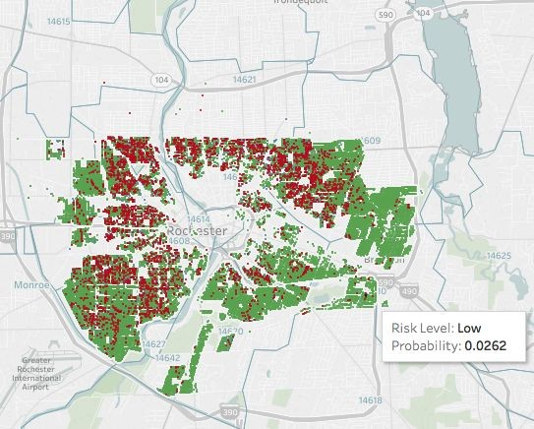
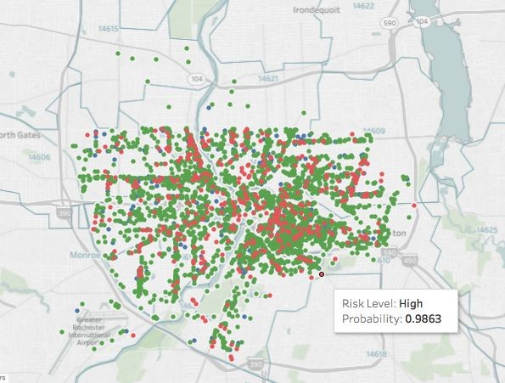
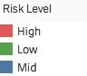

Slide 20
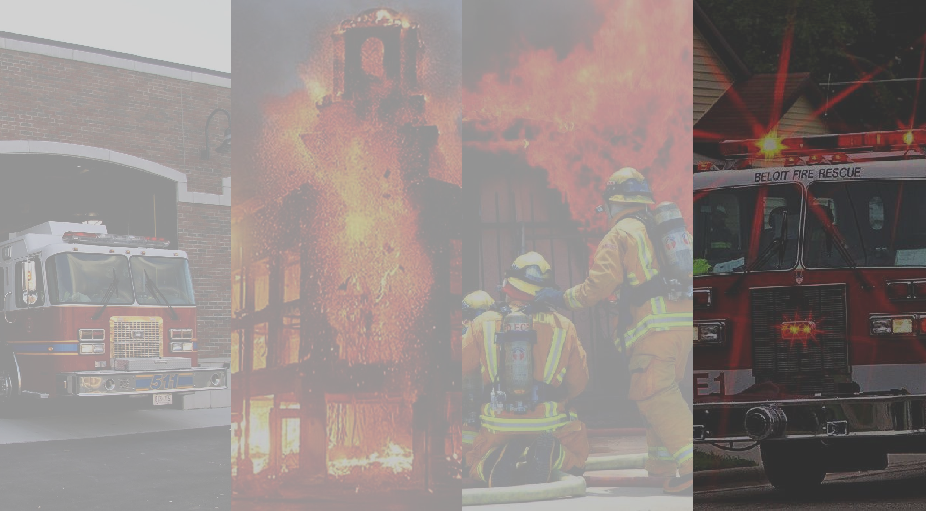

Slide 21
Inspections should be based on the following key predictors:
Residential’s top 5 significant fire predictors: structure values, vacancy rate, crowdedness rates, children rates, and non-white rates
Commercial’s top 5 significant fire predictors: structure values, gross sq ft,, male population rate, current land value, and crowdedness rate.
Utilize results from both fire prevention and operations to improve performance.

Slide 22

Research directions: Future research should seek to refine, expand, and further validate our prediction model.
Exploring more predictive variables (inspection data, crime data, causes of fire, etc.) to improve the model.
To help the client understand and implement model more easily, more interactive maps can be developed presenting fire incidents, current inspected structures, and potential inspectable structures in different colors.

Slide 23


